Slide 1

A Systematic Literature Review of Software
Visualization Evaluation
L. Merinoª , M. Ghafariª , C. Anslow^{b} , O. Nierstraszª
ªSoftware Composition Group, University of Bern, Switzerland
^{b}School of Engineering and Computer Science, Victoria University of Wellington, New Zealand
speaker: YingJian Xiao

Slide 2
Contents
01. Introduction
02. Related Work
03. Background
04. Methodology
05. Results
06. Discussion
07. Conclusion

Slide 3
1.Introduction
the low adoption of software visualization results from their unproved effectiveness and lack of evaluations
a characterization of the evaluation of software visualization approaches will：
(i) assist researchers in the field to improvethe quality of evaluations
(ii) increase the adoption of visualization among developers

Slide 4
1.Introduction
formulated the following research questions:
RQ1.) What are the characteristics of evaluations that validate the effectiveness of software visualization approaches?
RQ2.) How appropriate are the evaluations that are conducted to validate the effectiveness of software visualization?

Slide 5
1.Introduction
Reviewed 181 full papers of the 387 papers published in SOFTVIS/VISSOFT
62%(i.e., 113) of the proposed software visualization approaches either do not include any evaluation, or include a weak evaluation(i.e., anecdotal evidence, usage scenarios）
29% of the studies (i.e., 53) conducted experiments
7% (i.e., 12) of the studies conducted a case study
3% (i.e., 4) of studies conducted a survey

Slide 6
1.Introduction
This paper makes the following contributions:
1. A study of the characteristics of evaluations performed in the literature of software visualization.
2. Guidelines for researchers in the visualization field who need to evaluate software visualization approaches.
3. A publicly available data set including the information of the studies and classifications.

Slide 7
2.Related Work
A few studies have attempted to characterize the evaluation of software visualization approaches via a literature review.
Other studies have opted to evaluate software visualization tools and have reported guidelines.
A few reviews of the software visualization literature that focus on various domains have tangentially analyzed the evaluation aspect.
Similar efforts have been made in the information visualization field.

Slide 8
3.Background
The strategies that researchers adopt to evaluate the effectiveness of a software visualization approach can be classified into two main categories:
i) Theoretical principles from information visualization that provide researchers support to justify a chosen visual encoding.
ii) Empirical evidence gathered from the evaluation of a technique, method or tool.
a) exploratoryevaluations b) explanatory evaluations

Slide 9
3.Background
Amongst the strategies used in empirical evaluations:
(a) surveys (b) experiments (c) case studies
Several methods exist for collecting data in each evaluation strategy. :
(i) questionnaires (ii) interviews (iii) think-aloud
(iv) video recording (v) sketch drawing (vi) eye tracking

Slide 10
4.Methodology
review protocol
research questions
data sources and search strategy
inclusion and exclusion criteria
quality assessment
data extraction
selected studies

Slide 11
4.Methodology
4.1. Data sources and search strategy
Data source:the SOFTVIS and VISSOFT conferences
(i) the good B classification that they obtain in the CORE ranking
(ii) related work that concluded that results from the analysis of software visualization evaluation in papers published by other venues do not differ from those published by SOFTVIS/VISSOFT.

Slide 12
4.Methodology
4.2 Inclusion and exclusion criteria
reviewed the proceedings and programs of the venues to include full papers and exclude other types of papers that due to limited space are unlikely to contain enough detail.
from the 387 papers we excluded 178 papers that corresponded to:
(i) 61 poster
(ii) 52 new ideas and emerging results (NIER)
(iii) 44 tool demo (TD)
(iv) 8 keynote,
(v) 8 position
(vi) 5 challenge papers

Slide 13
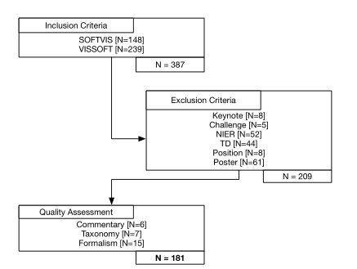
4.Methodology
4.3. Quality assessment
(a) Stages of the search process and number of selected studies in each stage.

Slide 14
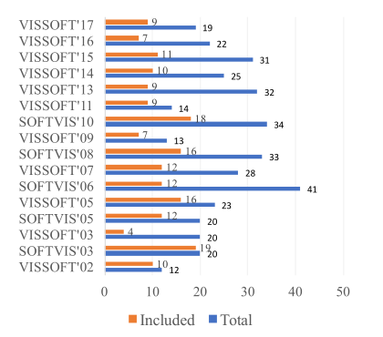
4.Methodology
4.3. Quality assessment
(b) The 181 included papers from the collection of 387 papers published in SOFTVIS/VISSOFT venues.

Slide 15
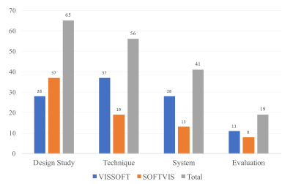
4.Methodology
4.3. Quality assessment
(c) Classification of the 181 SOFTVIS/VISSOFT full papers by type.

Slide 16
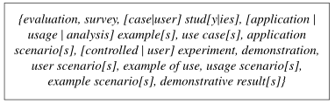
4.Methodology
4.4. Data extraction

Slide 17
4.Methodology
4.5. Selected studies

Slide 18
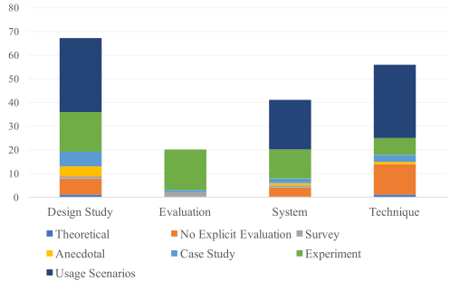
5.Results
Figure 2: The distribution of the 181 included papers categorized by paper types and research strategy used to evaluate software visualization approaches.

Slide 19
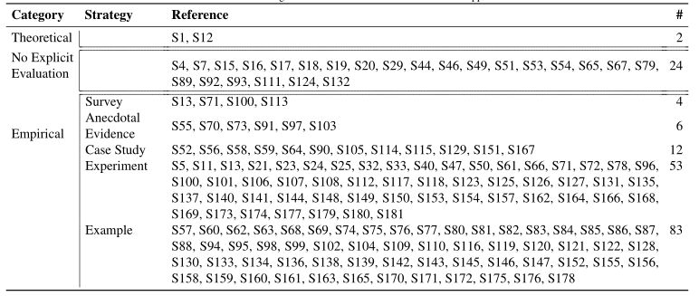
5.Results
Table 3: Research strategies used to evaluate software visualization approaches.

Slide 20
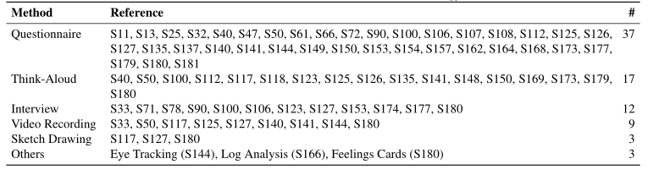
5.Results
5.1. Data Collection Methods
Table 4: Data collection methods used to evaluate software visualization approaches.

Slide 21
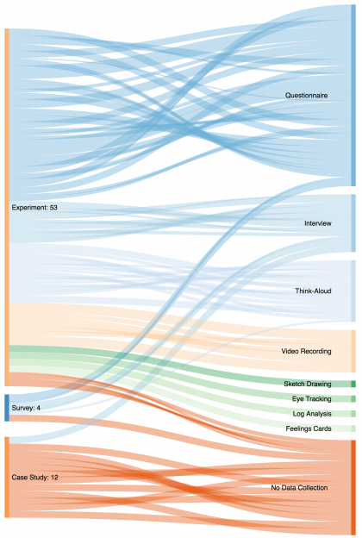
5.Results
Figure 3: Sankey diagram showing the data collection methods (right) employed in evaluation strategies (left) adopted in empirical evaluations.

Slide 22
5.Results
5.2. Evaluation Strategies
Anecdotal Evidence
Two papers proposed a visualization to support the student audience and reported that tools were successfully used in software engineering courses.
four studies that focused on the developer audience reported that visualizations were used intensively and obtained positive feedback.

Slide 23
5.Results
5.2. Evaluation Strategies
Usage Scenarios
most popular systems：
a)Java: ArgoUML、Ant、JHotDraw、 Java SDK、Weka
b)C++：Mozilla 、VTK、GNOME
c)Smalltalk：Pharo

Slide 24
5.Results
5.2. Evaluation Strategies
Survey
the low number of surveys has an effect on the disconnect between the proposed software visualization approaches and the needs of developers that we found in the past.

Slide 25
5.Results
5.2. Evaluation Strategies
Case Study
The case of the study describes the context of the project in which difficulties arise, and shows how a visualization approach provides developers support for tackling them.

Slide 26
5.Results
5.2. Evaluation Strategies
Experiment
Participants
Type of Analysis
Dependent Variables
Statistical Tests
Task

Slide 27
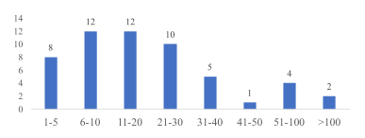
5.Results
5.2. Evaluation Strategies
Experiment
Figure 4: Histogram of the number of participants reported in evaluation.

Slide 28
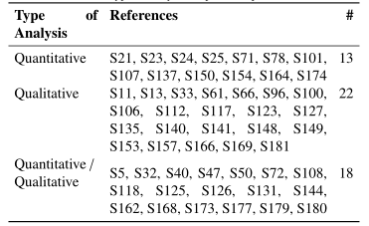
5.Results
5.2. Evaluation Strategies
Experiment
Table 5: Type of analysis adopted in experiments.

Slide 29
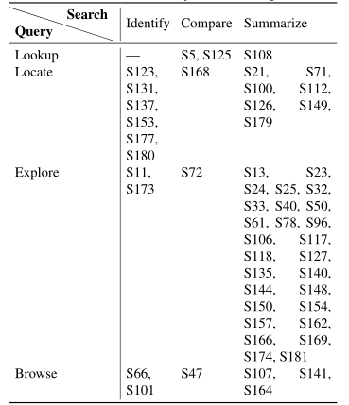
5.Results
5.2. Evaluation Strategies
Experiment
Table 6: Classification of tasks used in experiments according to Munzner

Slide 30
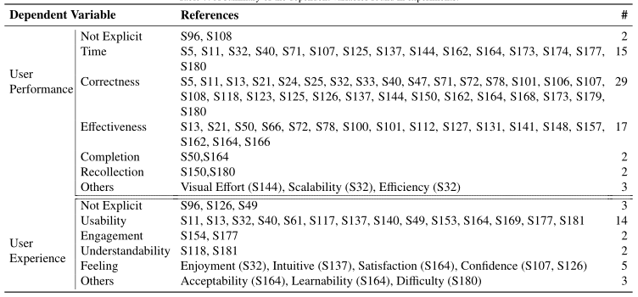
5.Results
5.2. Evaluation Strategies
Experiment
Table 7: A summary of the dependent variables found in experiments.

Slide 31
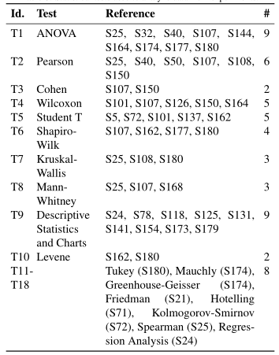
5.Results
5.2. Evaluation Strategies
Experiment
Table 8: Statistical tests used to analyze data from experiments.

Slide 32
6.Discussion
RQ1.) What are the characteristics of evaluations that validate the effectiveness of software visualization approaches?
Beyond traditional data collection methods.
Thorough reports of anecdotal evidence and usage scenarios.
The value of visualizations beyond time and correctness.
The case in case studies.
The scope of experiments in software visualization.

Slide 33
6.Discussion
RQ2.) How appropriate are the evaluations that are conducted to validate the effectiveness of software visualization?
Explicit goal of evaluations.
Experiments’ tasks must be in-line with evaluations’ goal.
Beyond usage scenarios.
Surveys to collect software visualization requirements.
Report on thorough experiments.

Slide 34
6.Discussion
Threats to Validity：
Construct validity
Internal validity
External validity
Conclusion validity

Slide 35
7.Conclusion
identified several pitfalls that must be avoided in the future of software visualization:
evaluations with fuzzy goals (or without explicit goals)
evaluations that pursue effectiveness without defining it, or that limit the assessment to time, correctness
experiment tasks that are inconsistent with the stated goal of the evaluation;
lack of surveys to collect requirements
lack of rigor when designing, conducting, and reporting on evaluation.

Slide 36
7.Conclusion
identified several pitfalls that must be avoided in the future of software visualization:
evaluations with fuzzy goals (or without explicit goals)
evaluations that pursue effectiveness without defining it, or that limit the assessment to time, correctness
experiment tasks that are inconsistent with the stated goal of the evaluation;
lack of surveys to collect requirements
lack of rigor when designing, conducting, and reporting on evaluation.

Slide 37
7.Conclusion
call researchers in the field to collect evidence of the effectiveness of software visualization approaches by means of:
case studies
experiments

Slide 38
THANKS

